Slide 1
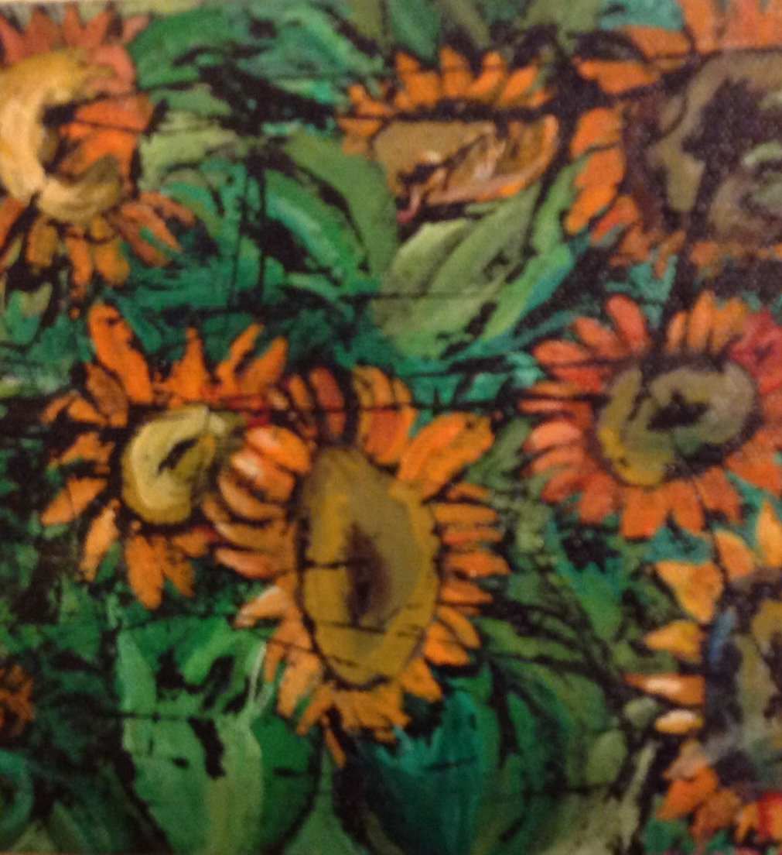
Fall Theme Tempera Resist Painting

Slide 2
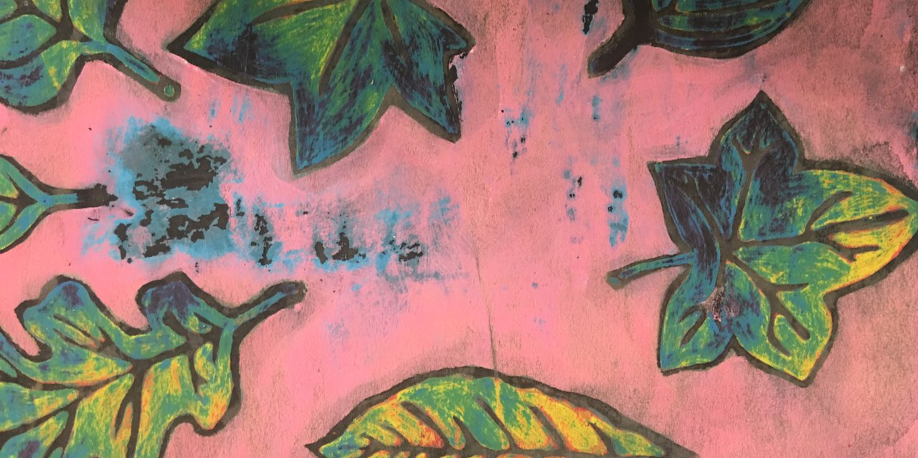
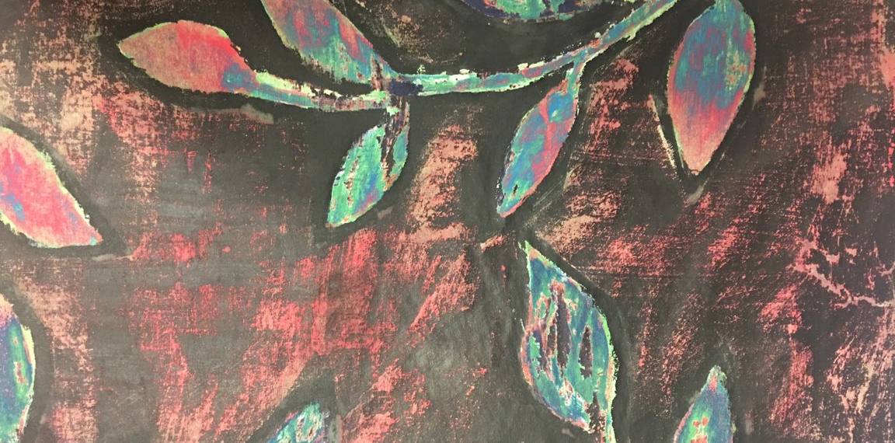
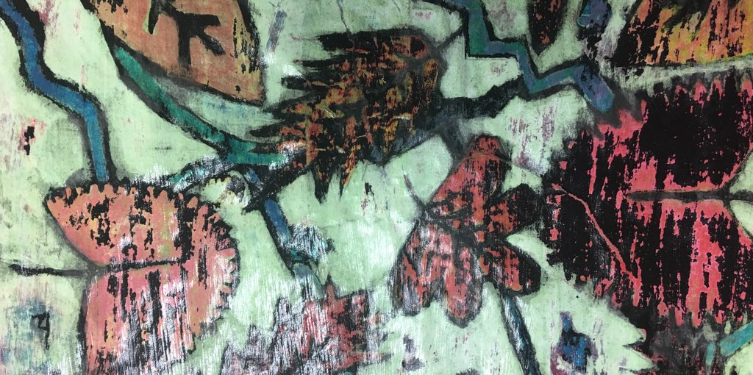
Description of the Tempera Resist Painting process…
What is Tempera Resist? A painting technique in which depth or darkness is added to an artwork by applying a waterproof ink to the base artwork.
Process steps…
Artist uses chalk to create their image outline.
Artist applies at least 4 layers of tempera paint onto the unchalked portions of their artwork. (Note: areas that are not completely painted will turn black after the ink is applied.)
After all layers of tempera paint have dried, the artist coats their artwork with black India ink.
To finish their artwork, the artist softly scrubs the surface of their paper to reveal the colors used throughout the tempera paint process.

Slide 3
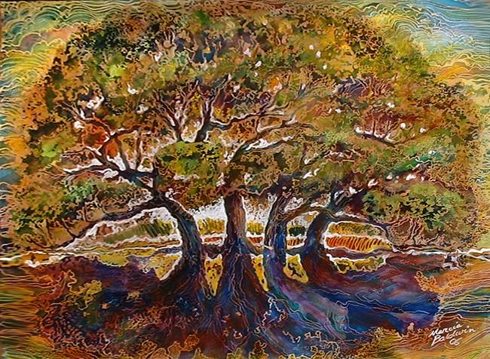
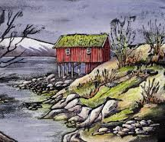
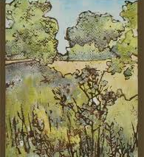
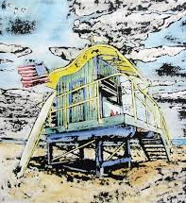
pARTner Discussion: Compare and contrast the tempera resist paintings on this slide.
Personal Reflection: What potential obstacles do you predict you will face throughout the creation of this process painting?

